Slide 1
AFRICAN ORAL LITERATUTRES AND DIGITAL ORALITY
MOBOLANLE EBUNOLUWA SOTUNSA
BABCOCK UNIVERSITY
KEYNOTE PRESENTED AT THE 4th CONFERENCE OF THE NIGERIA ORAL LITERATURE ASSOCIATION
20th OVTOBER 2016
AT UNIVERSITY OF ABUJA
NIGERIA

Slide 2
PRAMBLE
COMMENTS ON THE THEME
ORALITY, NEW MEDIA AND CREATIVE INDUSTRIES

Slide 3
INTRODUCTION
The indigenous knowledge of Africans is generally archived in oral traditions folklore. Ojaide asserts that
Folklore is the repository of a people’s indigenous and local knowledge in the forms of language, literature, legends, myths, epics, folktales, songs, proverbs, tongue-twisters, riddles, music, dance, art, religious beliefs and practices, medicinal treatments, and other customs and traditions

Slide 4
INDIGENOUS KNOWLEDGE
information gained through experience or education. It is the beliefs of a people arising from practical knowledge.
archived in their oral traditions or other aspects of their folklore.
ranges from proverbs, folktales and other oral narratives to epics, chants, and other poetic forms

Slide 5
PERFORMANCE
Performance is key in Oral Literatures
Oral art livesin performance
Performance art is a presentation genre that involves some degree of improvisation, in which an artist draws upon dance, music and drama.
In performance, different forms of expressions are mixed.
Performance arts also incorporate elements of audience involvement

Slide 6
ORALITY
people’s cultural memory;
Through orality, people of African descent vault immense knowledge and wisdom.
knowledge, art, ideas and cultural material is received, preserved and transmitted orally from one generation to another
recall and transmission of a specific, preserved textual and cultural knowledge through vocal utterance

Slide 7
THE CHALLENGE
Oral creative works are increasingly endangered as globalisation and rapid socio-economic change exert complex pressures on many African communities, especially smaller communities
Globalisation can erode expressive diversity and transform African culture through assimilation to more dominant ways of life.

Slide 8
THE CHANGING TIMES
Rapid socio, economic and political changes have occurred in Africa since the era of colonization and moreso in the present era of globalisation.
This changes have had far reaching effects on the societal modes of education, communication, governance structure, religions, languages, cultures and literatures.

Slide 9
CHANGING MODES OF COMMUNICATION
ORAL-WORD OF MOUTH
PRINT- WRITTEN AND PRINTED
ELECTRONIC- RADIO, TELEVISION, PHONES
DIGITAL

Slide 10
DIGITAL ORALITY
The invention and widespread use of the Internet, wireless networks, and mobile devices has created the ability to stay connected to electronic media, technology, and people at all times. Thus, we are currently experiencing amove from a print culture to a digital culture
(TIME BARROW)

Slide 11
Communication is one realm in which technological advancements seem most apparent
communication methods can, at times, seem cyclical or at least call upon previous methods that became out-dated.
This condition is, in part, due to the fact that new methods of communication are often born of earlier and existing methods.

Slide 12
WALTER ONG’S CLASSIFICATION: PRIMARY ORALITY
primary orality and oral means through which cultures without any form of writing communicate.
Following primarily oral cultures, chirographic (writing) cultures arrived and co-existed with oral cultures for a period of time.

Slide 13
SECONDARY ORALITY
‘secondary orality’
sustained by telephone, radio, television, and other electronic devices that depend for their existence and functioning on writing and print
oral/aural-based media beyond primarily oral cultures, including electronic orality

Slide 14
DIGITAL ORALITY
immediacy and hypermediacy
computer mediated communication
Archived in digital libraries
Based on technological advancement
Uses technological integration
hyperconnectivity,
decentralized collaboration
It involves Multiliteracies

Slide 15
MULTILITERACIES
“modes of representation much broader than language alone”
Integrated modes including
textual, visual, audio, spatial, behavioural
increasing complexity
multimodal ways of communication
visual, audio, and spatial patterns
increasing salience of cultural and linguistic diversity
characterized by local diversity and global connectedness

Slide 16
DIGITAL TECHNOLOGICAL TOOLS: PODCASTING
A podcast is an episodic series of digital media files which a user can set up so that new episodes are automatically downloaded via web syndication to the user's own local computer or portable media player. The word arose as a portmanteau of "iPod" (a brand of media player) and "broadcast".

Slide 17
DIGITAL TECHNOLOGICAL TOOLS: VODCASTING
Vodcasting (video-on-demand casting) is the same principle as Podcasting with the addition of video. Using a subscription "feed" simply means that you can subscribe and set your computer to automatically download new content as it becomes available. One format of subscription "feed" is RSS (Really Simple Syndication).

Slide 18
podcasting like television in that it is a pre-recorded, accessible file, which the user searches for (or happens upon serendipitously, in some cases), locates, and experiences.
whereas most television programs are professionally produced, censored, and pushed at a given time and date,
most podcasts are produced by individuals and are posted in set locations where a viewer can locate and pull the information whenever it is desired.

Slide 19
ELECTRONIC VERSUS DIGITAL AGE
Time Barrow
Radio is, perhaps the least changed, but digital and satellite radio has expanded
We still use phones to communicate, but we also use them for virtually everything else that our full computers do. The majority of phones used now are digital (cell) phones and function as planners, reminders, and other business related tools; they function as our televisions, radios, game systems, and other entertainment, and they also function as phones,
Television has expanded greatly over the last 20-30 years in the amount and the diversity of what is available, but one can now record shows digitally, watch multiple shows at once (screen-in-screen),
while our purpose for each of these media may not have altered drastically, the individual control we have over the media is greatly enhanced.

Slide 20
Our current oral communication methods – those classifiable as digital orality – are still closely tied to electronic orality, since digitalization is electronic. However, digital orality differs significantly enough to be deemed a unique and next phase.

Slide 21
NEED FOR DIGITAL ORALITY SKILLS
We need to acquire it for ourselves
Need to teach it
Need to empower oral artist to exploit it for visibility
Future preservation

Slide 22
DIGITAL LITERACY
to use digital orality tools, both as a listener/audience and as a speaker/orator, requires a new literacy

Slide 23
ADVANTAGES OF DIGIYAL ORALITY
benefit of the human orator, presenting his or her ideas with original intended voice intonation and (with the inclusion of video) physical gesture, combined with many benefits that come with the printed word, such as the ability to pause, replay, review, study, annotate, fractionate, save, store, copy, redistribute, etc.
Is digital orality is better or is worse than any other phase that has preceded it? – NOT FOR THIS DISCUSSION

Slide 24
NEW MEDIA
innovative ways for people to communicate with one another
(social network sites, blogs, chatrooms, discussion forums, podcasts, avatar-based interaction);
new ways to experience the world (augmented reality, massive multiplayer online
new forms of representation (Facebook, avatars, personal web pages, zines, and virtual social worlds such as Second Life);
inventive ways to produce and consume media (fanfiction, teletubing, reality TV, and multimedia editing).
(Sonya Milly The eLiterate Revolution: From Orality to New Media)

Slide 25
CREATIVE INDUSTRIES
a broader range of activities which include the cultural industries plus all cultural or artistic production, whether live or produced as an individual unit.
The creative industries are those in which the product or service contains a substantial element of artistic or creative endeavour and include activities such as architecture and advertising.

Slide 26
CULTURAL INDUSTRIES
industries which combine the creation, production and commercialization of creative contents which are intangible and cultural in nature. The contents are typically protected by copyright and they can take the form of a good or a service. Cultural industries generally include printing, publishing and multimedia, audiovisual, phonographic and cinematographic productions as well as crafts and design

Slide 27
THE VALUE OF CREATIVE/CULTURAL INDUSTRIES
"human creativity is the ultimate economic resource," (Florida 2002, p. xiii)
“the industries of the twenty-first century will depend increasingly on the generation of knowledge through creativity and innovation" (Landry & Bianchini 1995, p. 4).
New media will preserve cultural heritage while increasing the circulation of creative works

Slide 28
THE VALUE OF CREATIVE/CULTURAL INDUSTRIES –CULTURAL WEALTH
cultural industries are more concerned about delivering other kinds of value—including cultural wealth and social wealth—
Cultural industries include industries that focus on cultural tourism and heritage, museums and libraries, sports and outdoor activities, and a variety of 'way of life

Slide 29
SUMMARY
CULTURE IS DYNAMIC
TECHNOLOGICAL ADVANCEMENT HAS TRANSFORMED THHE WORLD
THE DIGITAL AGE
ORALITY IS A DENOMINATOR EVEN IN THE DIGITAL AGE

Slide 30
CONCLUSION
Nigeria is a country flowing with a rich cultural heritage
Cultural production and reproduction is dynamic
Creative and Cultural Industries have potentials for value and wealth generation
Creative and Cultural Industries are hinged on digital awareness and Literacy
interface between continuity and renewal in the study of folklore (G G Darah)

Slide 31
RECOMMENDATIONS
Need for training in digital archiving methods by government, institutions, grant/funding bodies. Non governmental bodies- NOLA
Need for online digital access to the materials (guided by the needs and desires of the originating community. Options include an entire collection being freely available to all through the Web, more restricted levels of access to community members only by means of a secure login)

Slide 32
Need to carefully address intellectual property rights and access to digitized oral texts

Slide 33
Bó bá ṣe p’émi nì’wọ ni If I were you
nì‘wọ ni were you
Ǹ bá fa pá jó, fa pá jó, I would dance with my hands
fa pá jó With my hands, I would dance
Bó bá ṣe p’émi nì’wọ ni, If I were you
nì‘wọ ni were you
Ǹ bá f’ẹsẹ̀ jó, f’ẹsẹ̀ jó, I would dance with my legs
F’ẹ sẹ̀ jó With my legs, I would dance
Bó bá ṣe p’émi nì’wọ ni ni If I were you
Ǹ bá fi gbogbo ara jó I would dance with my whole
Body
(A drum text inspiring and directing good dancing)

Slide 34
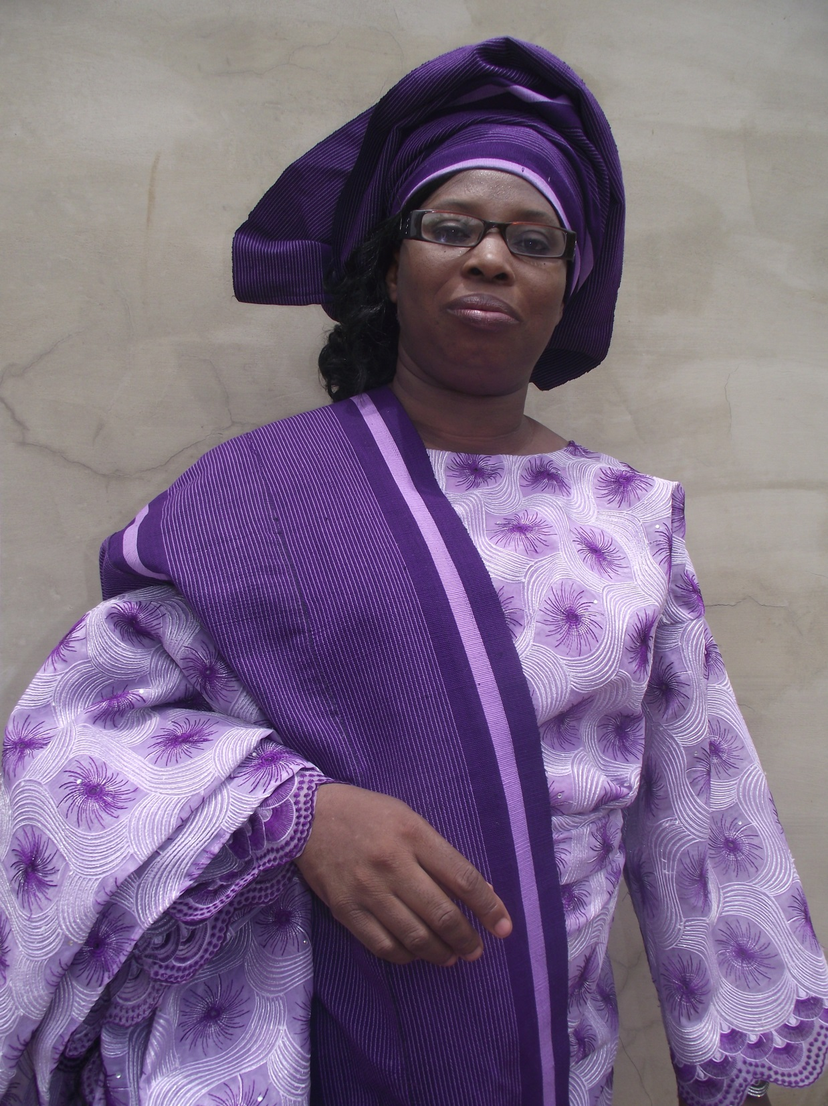
THANK YOU FOR YOUR ATTENTION

